Slide 1

Lesson 0.5: Snap! Coordinate System
Microsoft Philanthropies TEALS Program
Introduction to Computer Science

Slide 2
Snap! Coordinate System
After this lesson, you will be able to...
Recall the Cartesian Coordinate system
Implement the coordinate system to position a sprite using Snap Coordinates

Slide 3
Today’s Plan
Do Now
Introduction to the Snap! Coordinate System
Integrate Coordinate Concept to Snap!
Lab Activity
Debrief and wrap- up
Notes:
5 minutes | Do Now
10 minutes | Introduce Snap! Coordinate System
15 minutes | Integrate Coordinate Concept to Snap!
15 minutes | Lab Activity
5 minutes | Debrief and wrap-up

Slide 4

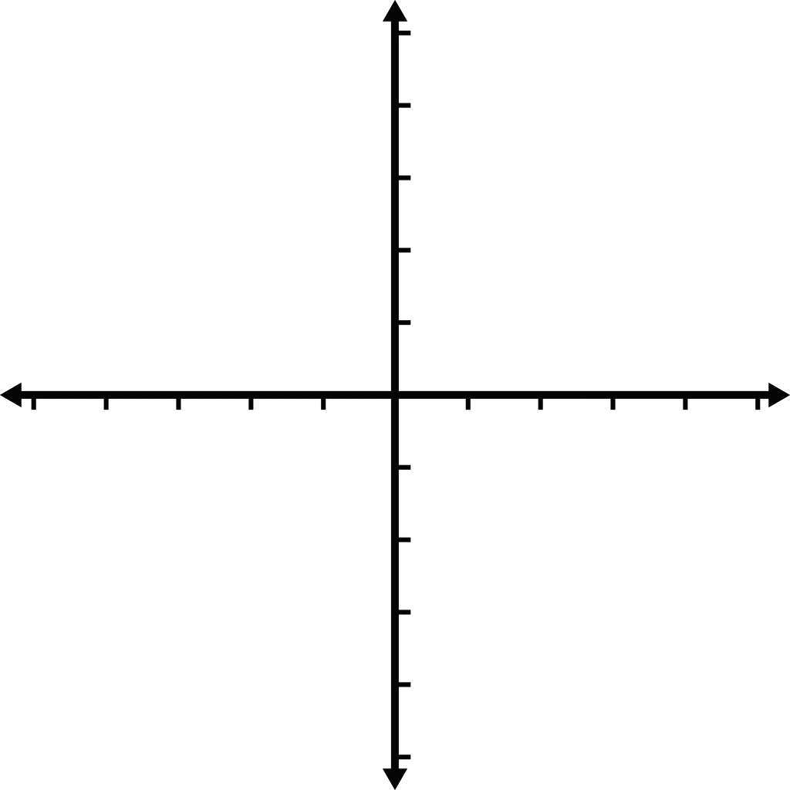
Do Now 0.5: Draw the Coordinate System
In your Notebook, Draw this image to the best of your ability
In your Notebook, Draw this image to the best of your ability

Slide 5

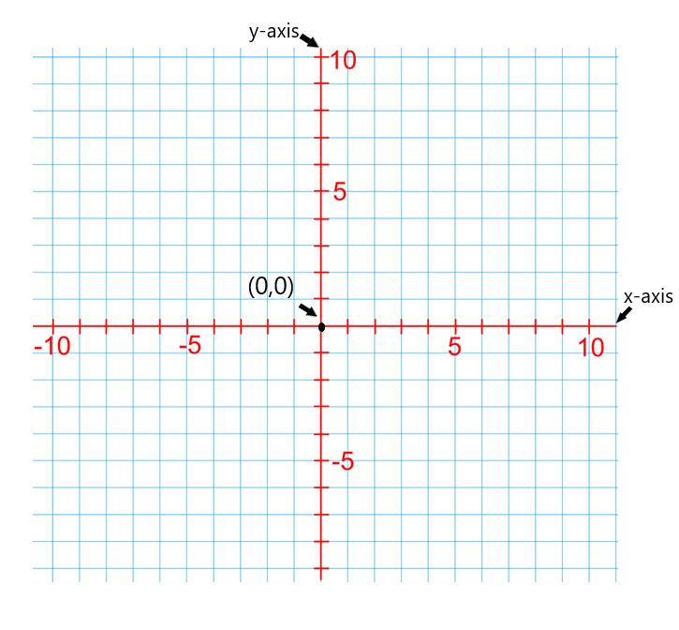
Introduce the coordinate plane
Origin (0,0)
x-axis
y-axis
Notes:
Tell students that today they will explore SNAP and use it to create a "self-portrait" program.
Emphasize that the goal of today's lesson is not for students to develop a deep understanding of any of the features in SNAP. Later lessons will teach them everything they need to know. For now, they should just explore, figure out what they can, and put it to use however they see fit.
Spend just a couple minutes demonstrating how to open SNAP, create sprites and scripts, and run programs.

Slide 6
Demonstrate plotting points
(5, - 5)
(2, 3)
(1, 4)
(-8, 5)
(-3, -4)
Notes:
Use in the drawing tool to plot these points as the students plot them in their notebook.

Slide 7
Activity
Navigate to https://www.desmos.com/calculator/ui4klsjued
Plot the following Points
(0,0)
(50,-50)
(100,0)
(50,100)
If you connected the dots, what shape would the points make?
Notes:
This activity is Optional if your class needs the additional scaffolding
Together as a class, practice plotting a few points on the Snap! Coordinate System.
Use [this coordinate tool](https://www.desmos.com/calculator/ui4klsjued) to have student plot points.
* This has pre-configured with the dimensions of the Snap using a grid so they can see the points being graphed.
* Have students plot the points on the left side of the tool and the points will appear on the graph.
* Note that the grid lines are set to 10 unit increments
* Have them plot the following points
* (0,0) "
* (50,-50)
* (100,0)
* (50,100)
Ask students if they connect the dots, what shape would the points make? (Answers may vary.. Kite, Diamond, Quadralateral, Polygon etc)

Slide 8
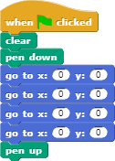
Integration Activity
Navigate to Snap Template
Enter the following points into the Go To Blocks in the template
(0,0)
(50,-50)
(100,0)
(50,100)
Click the Green Flag to see the sprite draw
Now take a few minutes and draw a couple shapes on your own
Notes:
Explain to students that this is how the Snap! stage is setup but it doesn't have a grid to view.
The origin (0,0 is the exact center of the grid)
Now have students enter the same coordinates using this [Snap! template](https://snap.berkeley.edu/snap/snap.html#present:Username=aspiece%40gmail.com&ProjectName=Snap%20Coordinate%20System%20Intro)
* Have them enter the following points into the **Go To Blocks** in the template
* (0,0) and add a label "Origin"
* (50,-50)
* (100,0)
* (50,100)
* Now have students click the Green Flag to see the sprite draw the same shape they described in the coordinate plane from the introduction above.
* Now instruct the students to use the block template to draw at least two shapes of their own.

Slide 9

Lab 0.5: Getting to know Coordinates – Part 1
The Peabody Test
Navigate to the Peabody Test
Open the link above
Click on Peabody to start the test
Answer his question in the textbox
You should answer at least 10 of his questions.
Notes:
Students will need to navigate to this link to do the Peabody Test:
https://snap.berkeley.edu/snap/snap.html#present:Username=georgesb&ProjectName=coordinatesTest&editMode&noRun

Slide 10
Lab 0.5: Getting to know Coordinates - Part 2
Plot a drawing using the Snap Template
Using the template from the classroom activity, create a drawing that has at least 10 coordinates. Save the drawing in Snap! and submit the URL to your teacher.
Reminder: Don't forget to log into Snap! and save your work.
Notes:
Students will need the Snap Template link - https://snap.berkeley.edu/snap/snap.html#present:Username=aspiece%40gmail.com&ProjectName=Snap%20Coordinate%20System%20Intro

Slide 11

Debrief
Can you think of any other technologies that use a coordinate system to display graphic?
Are there any blocks that you have discovered that have helped you do shapes faster?
Notes:
Ask each student to identify and describe one feature they discovered in SNAP. Keep a running list on the whiteboard or projector.
If the students build a pretty comprehensive list, you can use this as a chance to go over a brief roadmap for the course.
Ask students what they enjoyed about working with SNAP and what they disliked

